Slide 1
OBJECTIVE
To develop a user-friendly web platform that empowers citizens to report urban infrastructure issues easily, effectively bridging the gap between residents and local government.
By designing and developing a secure, web-based Civic Issue Reporting System, the project allows citizens to submit reports efficiently while providing authorities with a professional environment to track and resolve these issues in a highly organized way.

Slide 2
ABSTRACT
In the field of digital governance and smart city development, efficient management of public grievances plays a crucial role in improving urban infrastructure and citizen satisfaction. The system enables citizens to digitally submit complaints related to public infrastructure problems such as broken street lights, water leakage, garbage accumulation, and other municipal concerns.

Slide 3
LANGUAGE USE & FRAMEWORK
Stack used : MERN
Frontend : React, HTML , JavaScript, Tailwind CSS
Backend : Node.js, Express.js, MongoDB
Security : JWT Authentication

Slide 4
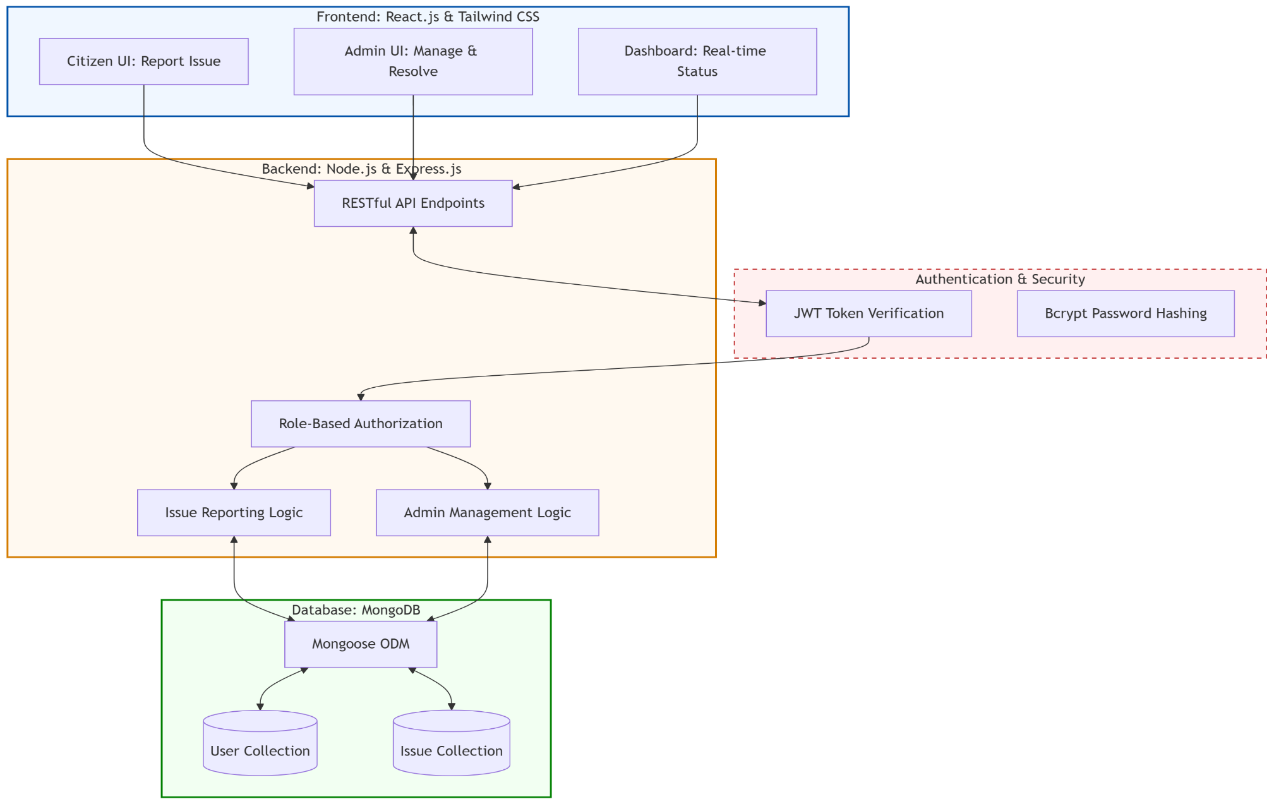
SYSTEM ARCHITECTURE

Slide 5
MODULES DESCRIPTION
1. Authentication & Security Module
Purpose: Manages user access and protects sensitive administrative routes.
Key File: middleware/auth.js.
Functionality: This module validates user credentials and manages session states or tokens to ensure that only authorized citizens or officials can modify report statuses.

Slide 6


K.RAMAKRISHNAN COLLEGE OF ENGINEERING
(AUTONOMOUS)
DEPARTMENT OF INFORMATION TECHNOLOGY
A Digital Framework for Centralized Reporting and Resolution of Urban Infrastructure Problems
Presented by,
Name : ROOPASREE P
Register No. : 8115U23IT085
Roll. No. : ITB2323
Year & Section : III- IT B
Course Code : ITC1371
Course Name : FULL STACK DEVELOPMENT
Date: 06.05.2026

Slide 7
2. Issue Reporting Module
Purpose: Handles the core business logic for creating and storing urban complaints.
Key Files: models/Report.js, middleware/upload.js.
Functionality:
Data Modeling: Defines the structure of a "Report," including location, category, and status.
File Handling: Manages the logic for uploading and storing images or documents as photographic evidence for the report.

Slide 8
Database Management Module
Purpose: Provides a persistent storage layer for all system data.
Technology: MongoDB.
Functionality: This module uses schemas (defined in the models/ directory) to ensure data consistency for users and civic issues across the platform.

Slide 9
Administrative & Reporting Module
Purpose: Empowering officials to analyze data and close tickets.
Key Features: xlsx integration.
Functionality: This module allows administrators to view all active reports and export urban data into Excel formats for offline analysis and government record-keeping.

Slide 10
User Interface Module
Purpose: Provides a responsive portal for citizens to interact with the system.
Component: Represented by the ux/ directory and related web assets.
Functionality: This module translates complex backend data into a user-friendly dashboard where residents can see their report history and view a map of community issues.

Slide 11
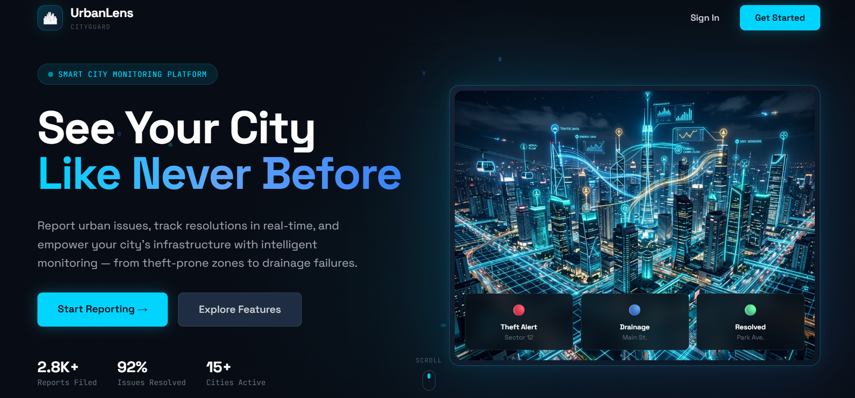
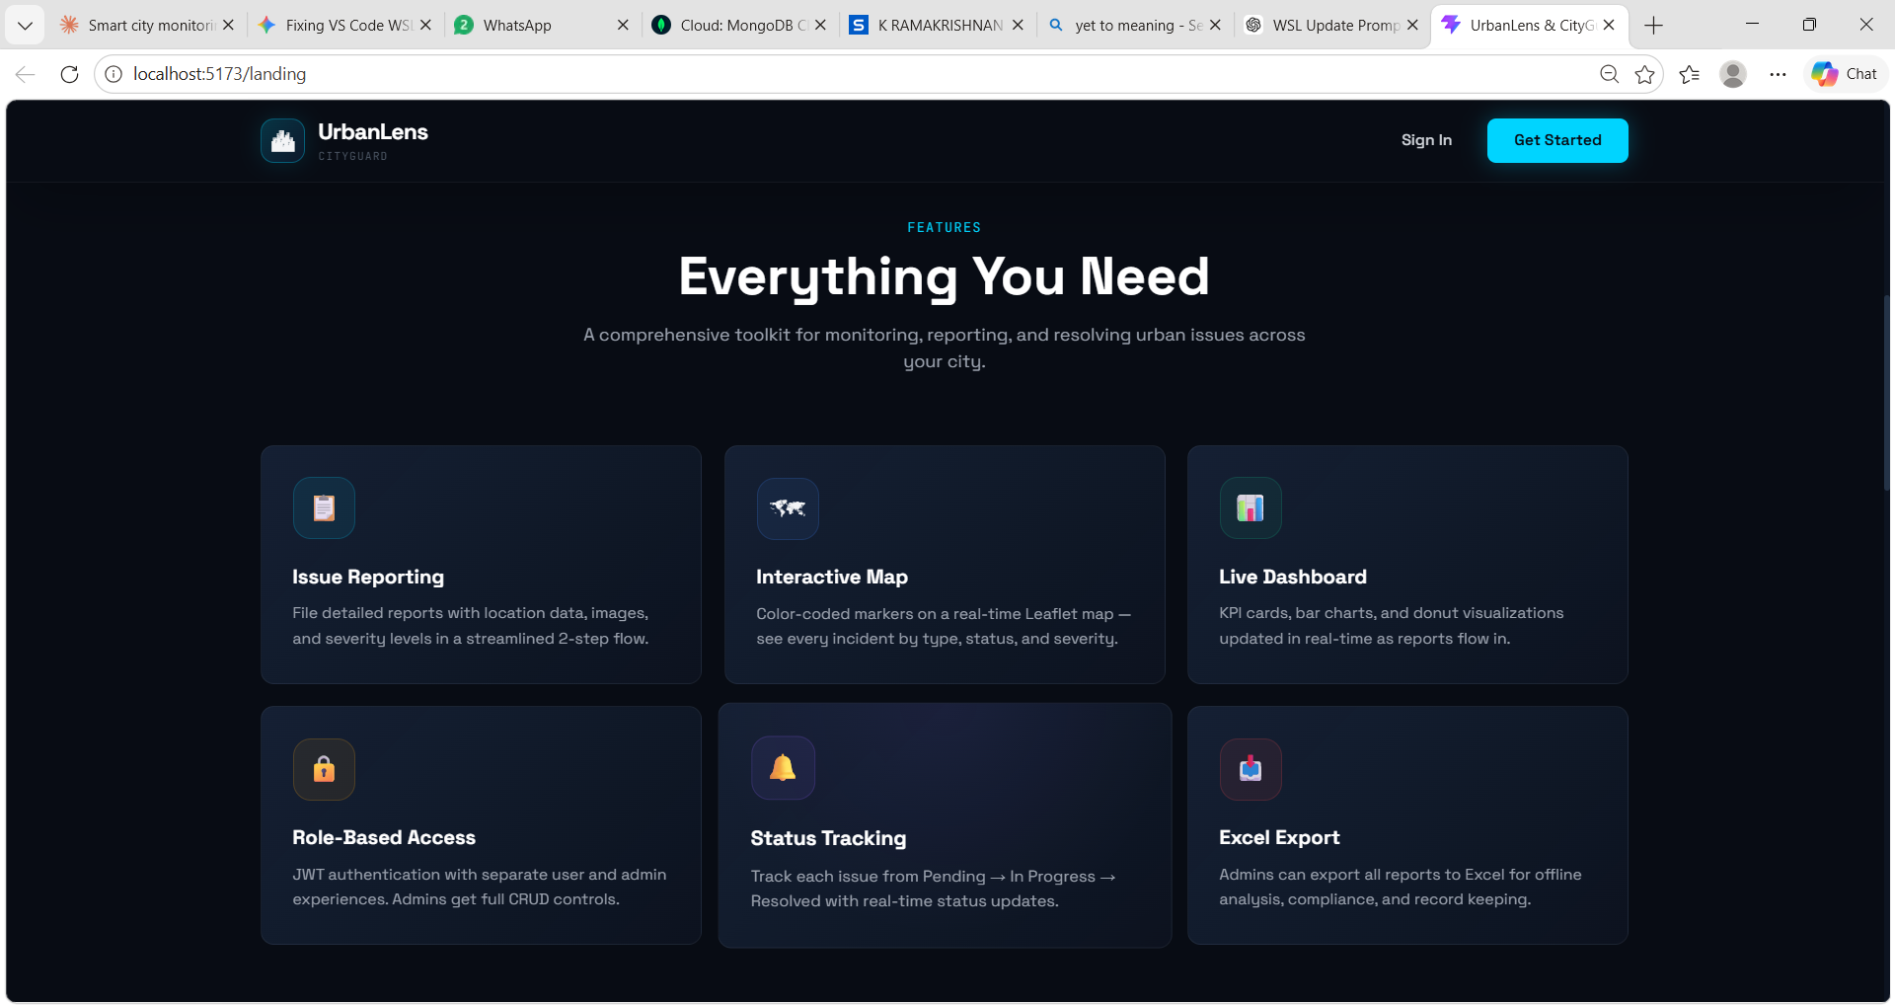
Output

Slide 12
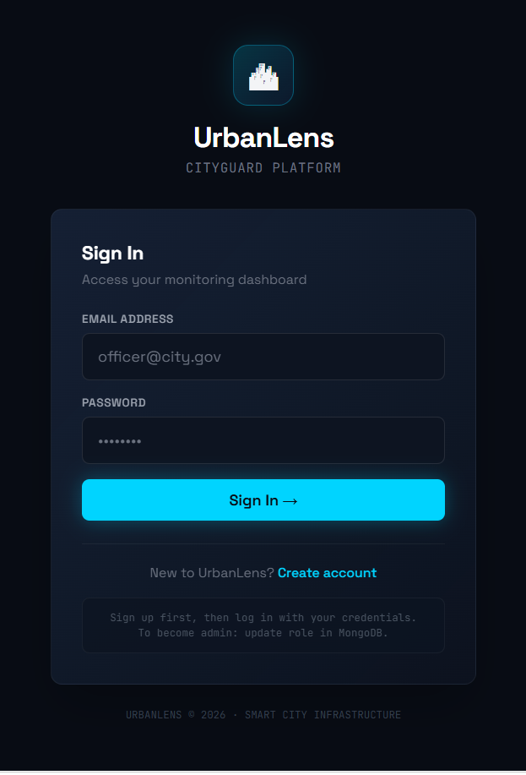
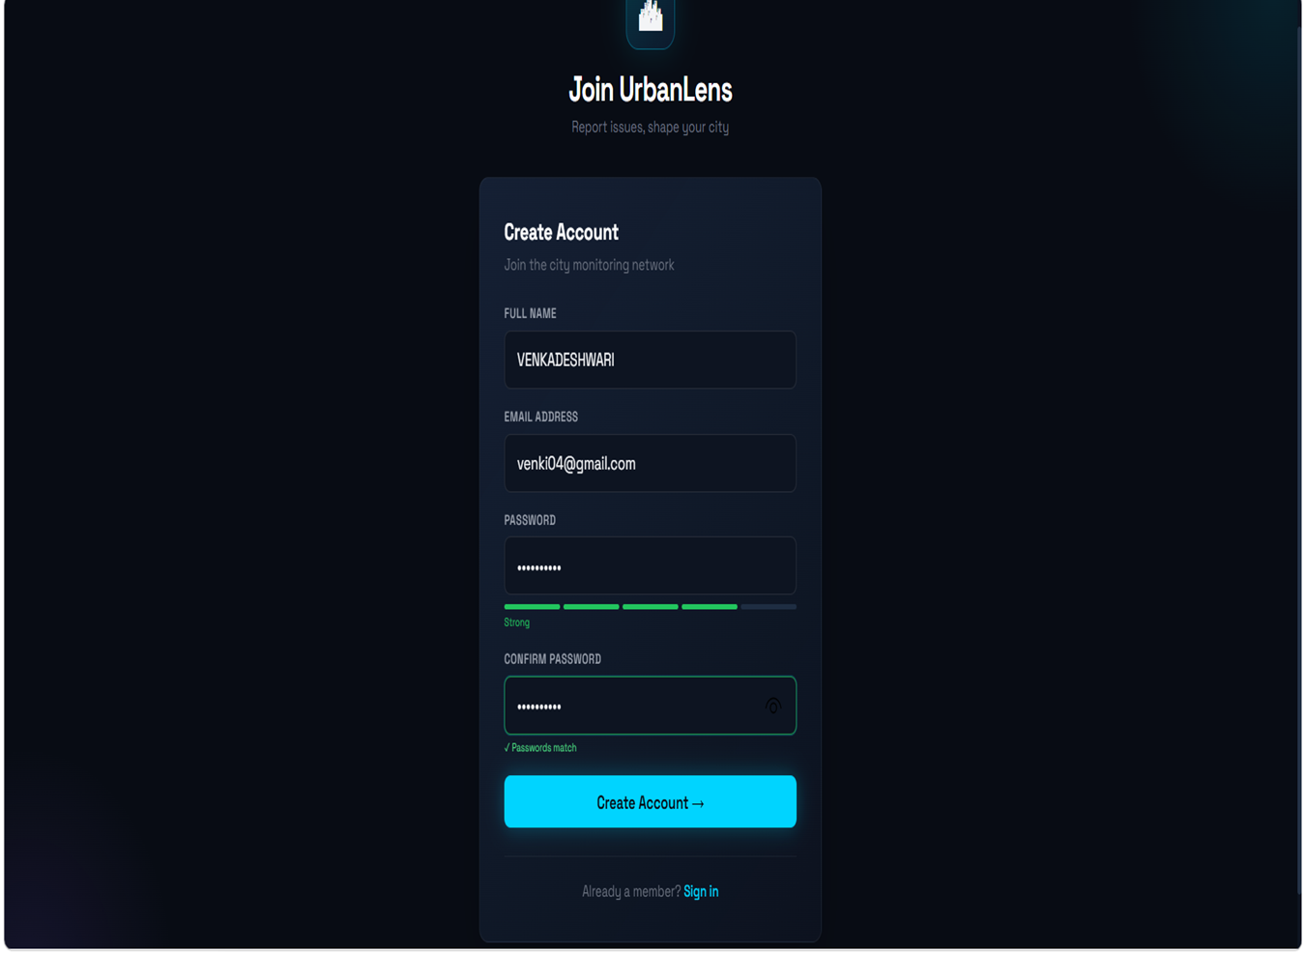

Slide 13
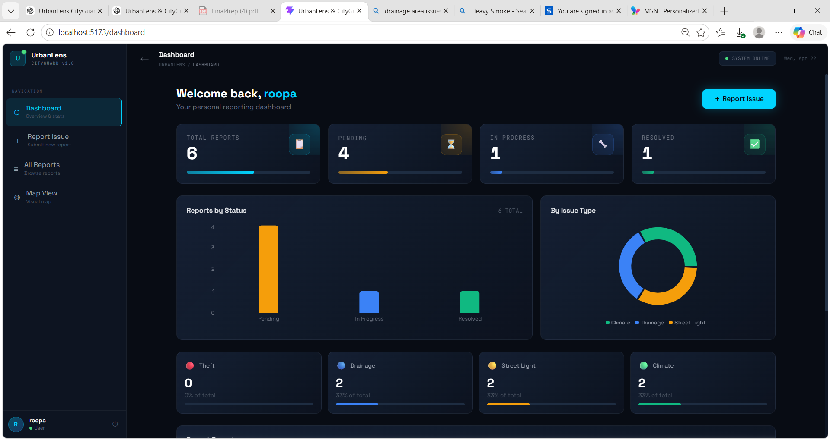
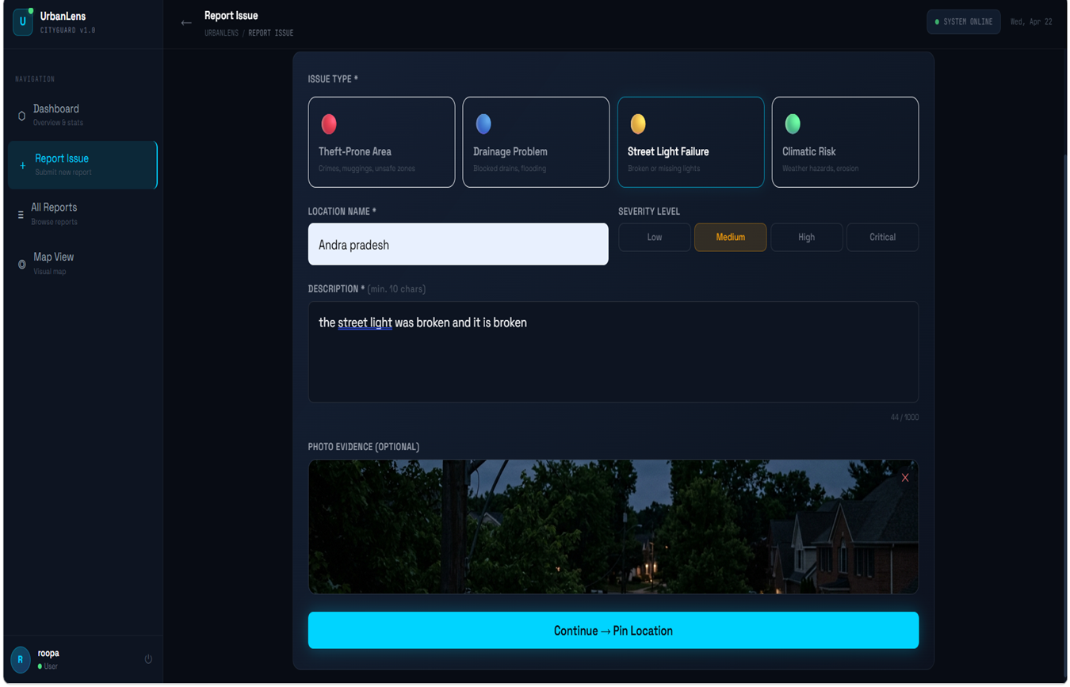

Slide 14
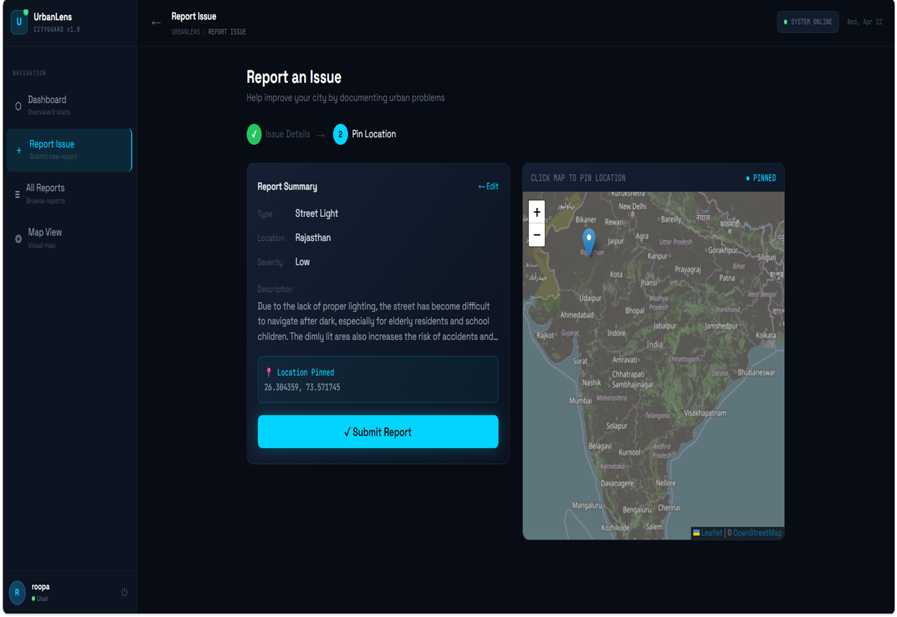
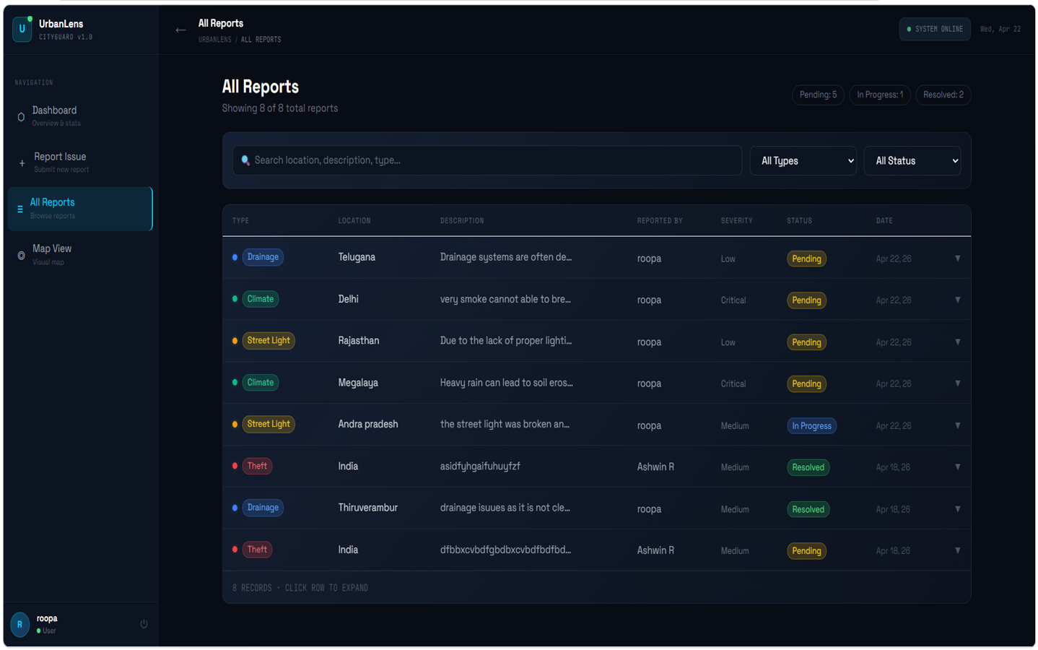

Slide 15
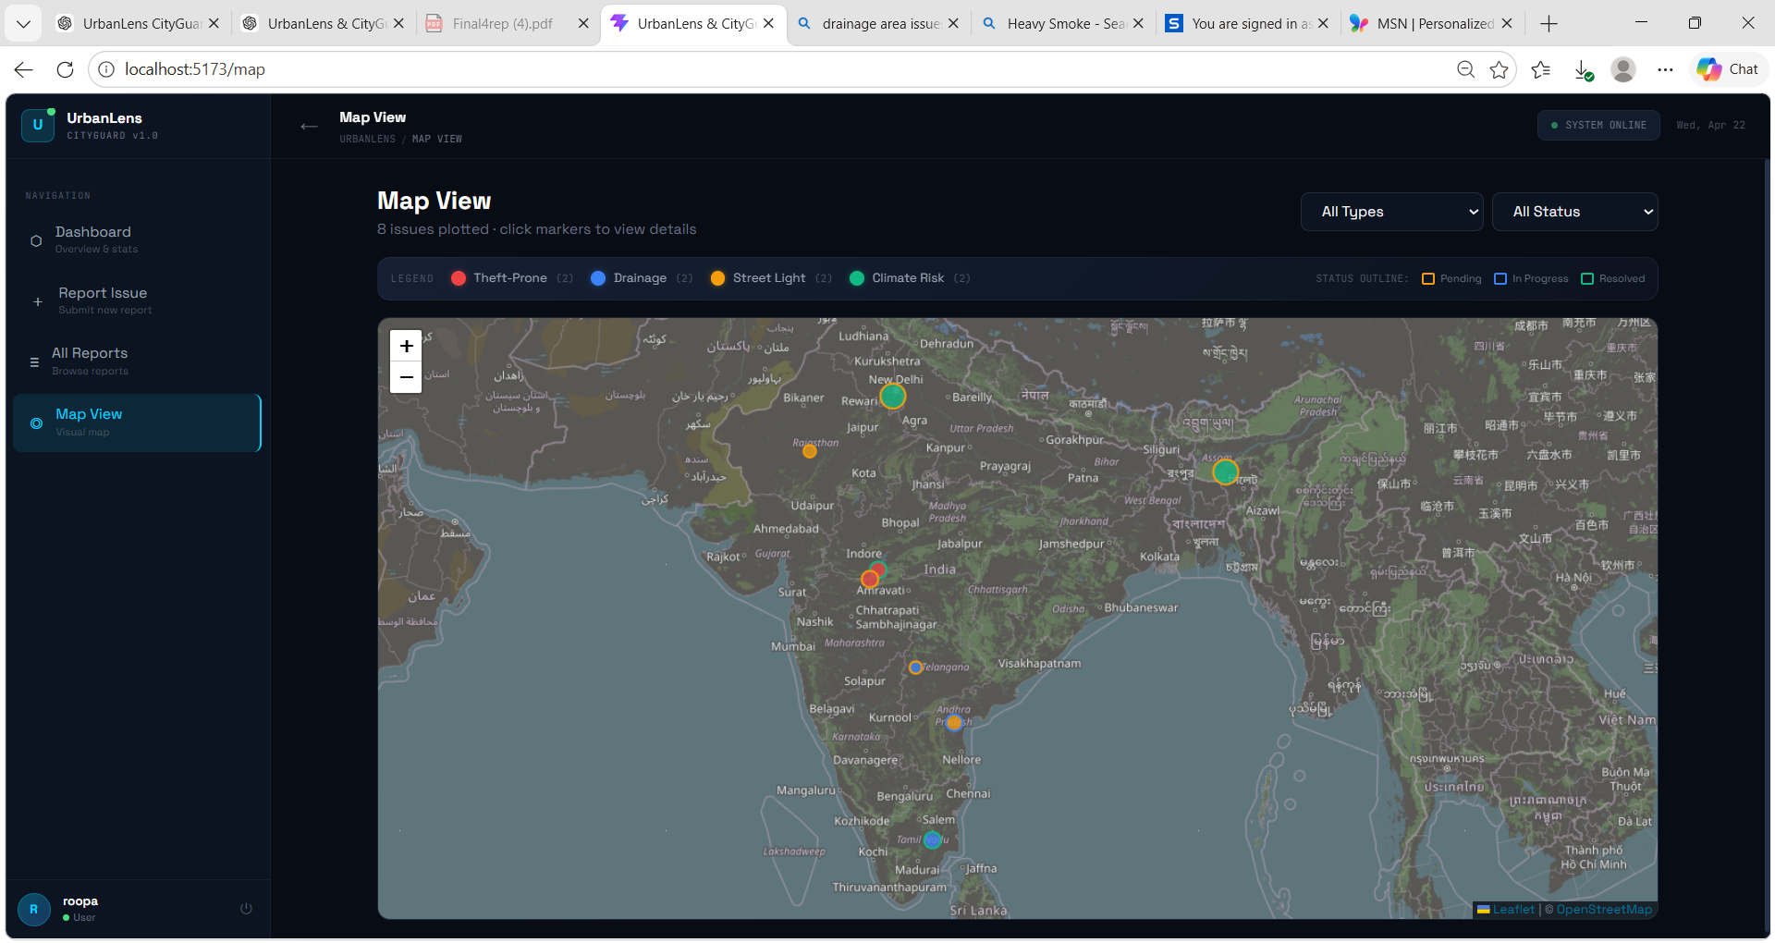

Slide 16
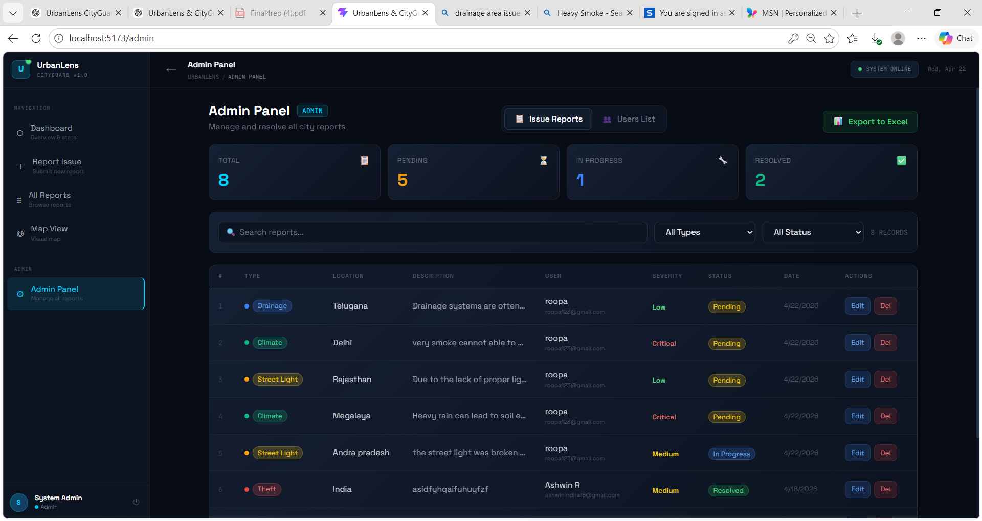
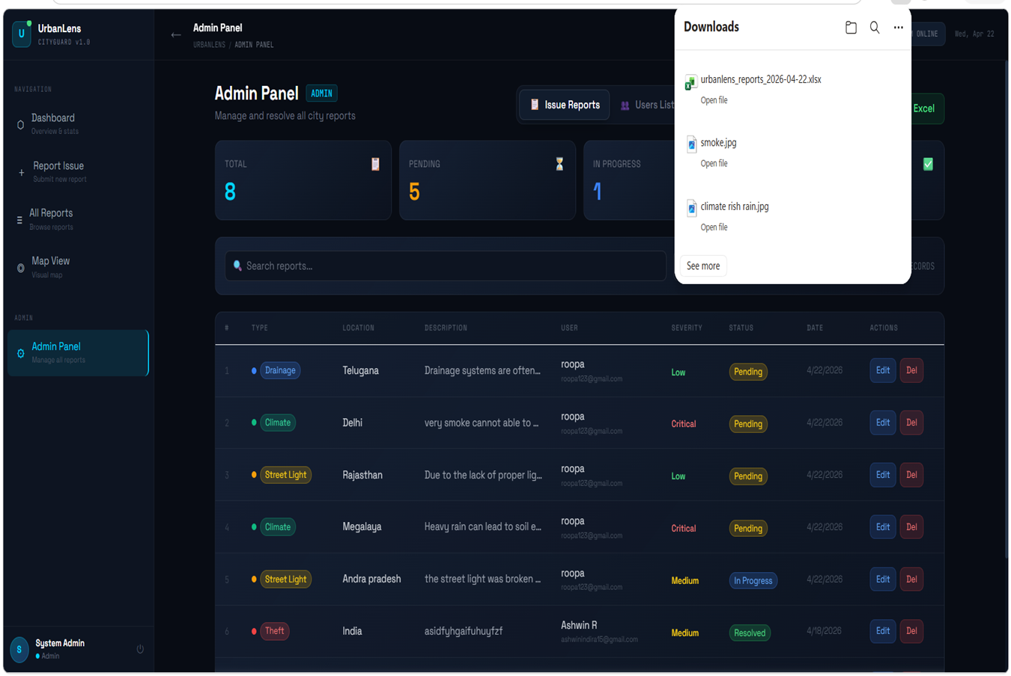

Slide 17
Conclusion
This project is a smart system that allows users to report urban issues and track their status, while administrators monitor all reports and update their progress. It improves transparency, enables faster issue resolution, and promotes better coordination between citizens and authorities for safer and more efficient city management.

Slide 18
Future Enhancement
The UrbanLens & CityGuard can be enhanced by integrating with government systems for verified data and faster response, along with GPS-based location tracking for accurate issue reporting, making the platform more reliable and trustworthy.

Slide 19
Thank you

